Slide 1
虛擬儀控之設計與應用 期末專題 百步穿楊(射箭模擬器)
許心平 R09522608

Slide 2
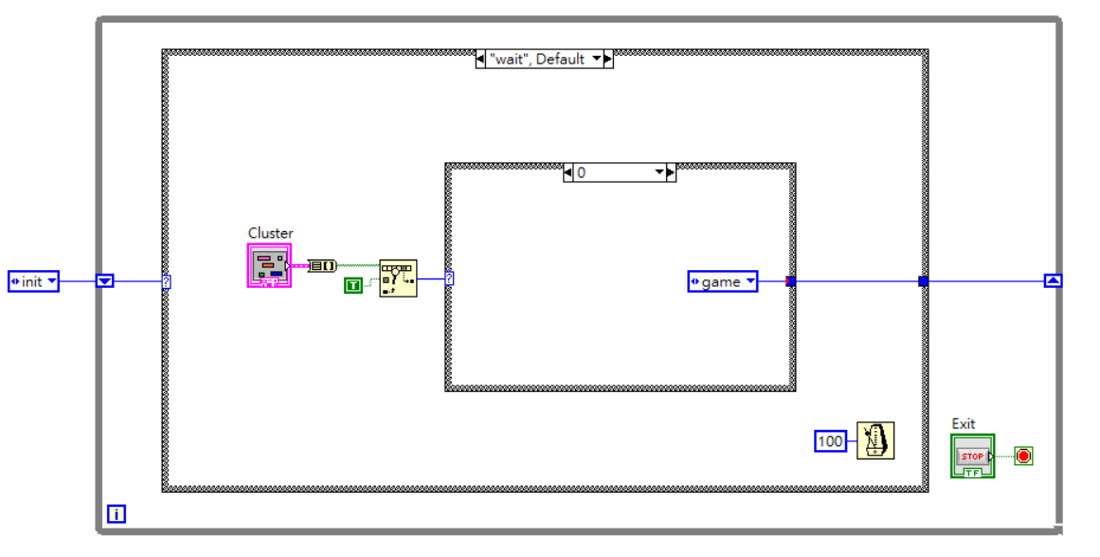
main vi Using State machine
Init
Wait
Game (subvi)
Highscore (subvi)
Hint (subvi)
About (subvi)

Slide 3
Game
Play game
Parameters
Mouse event & Motion
Result
Record highscore

Slide 4
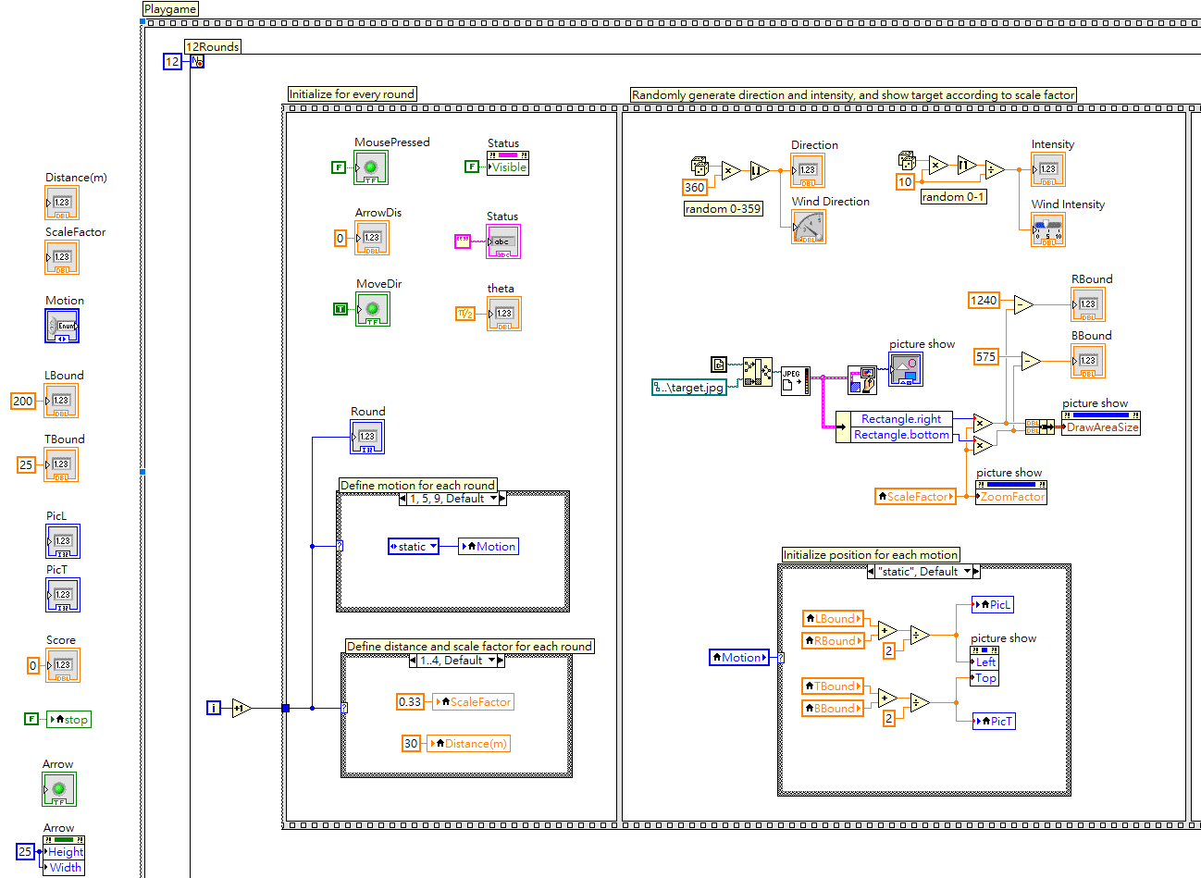
Play game / Parameters

Slide 5
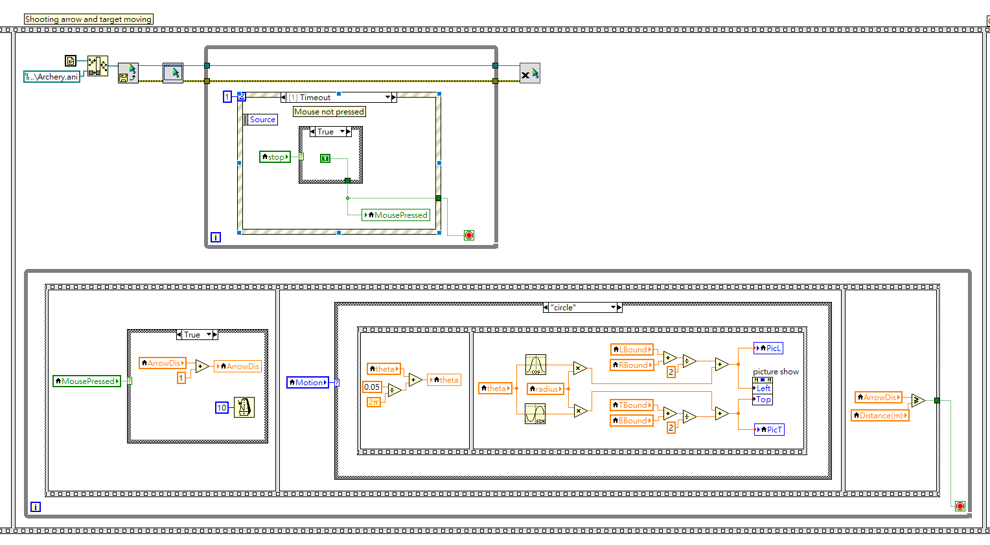
Play game / Mouse event & Motion

Slide 6
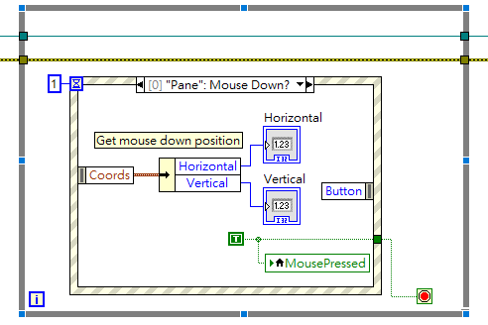
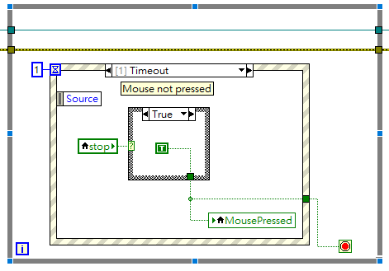
Mouse down event
Event structure to capture mouse position

Slide 7
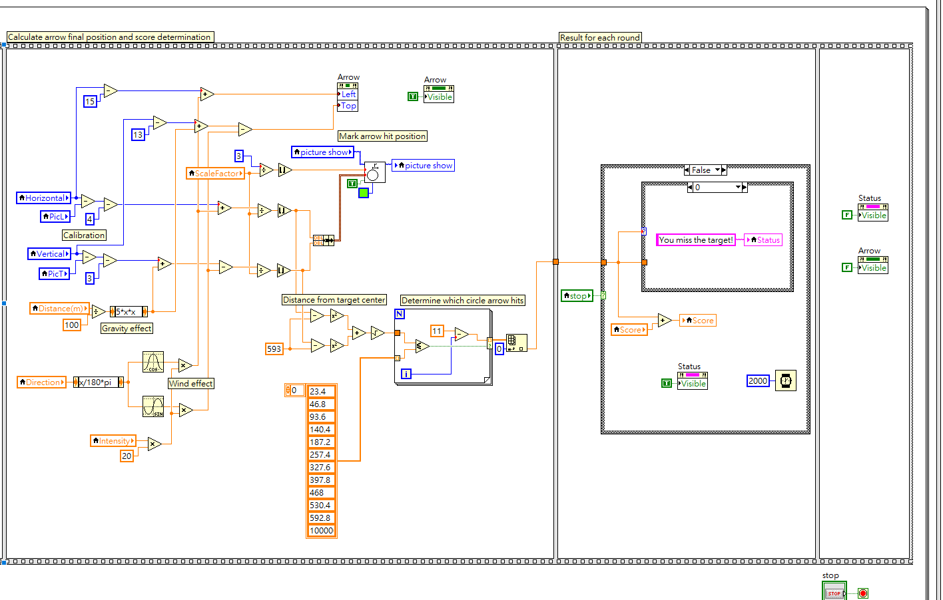
Play game / Result

Slide 8
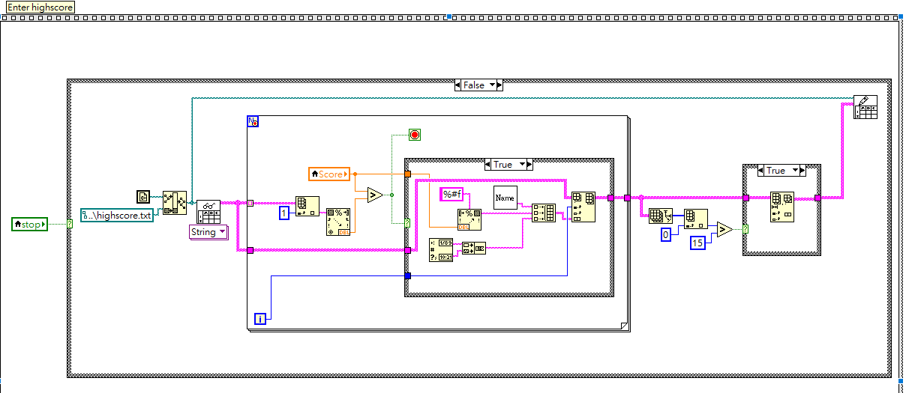
Record highscore

Slide 9
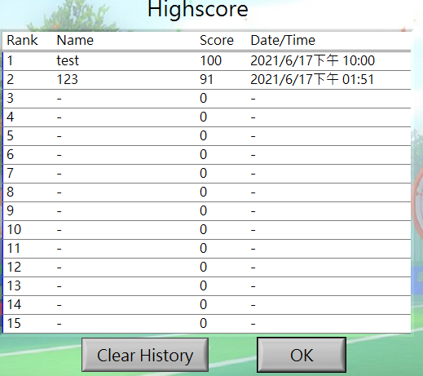
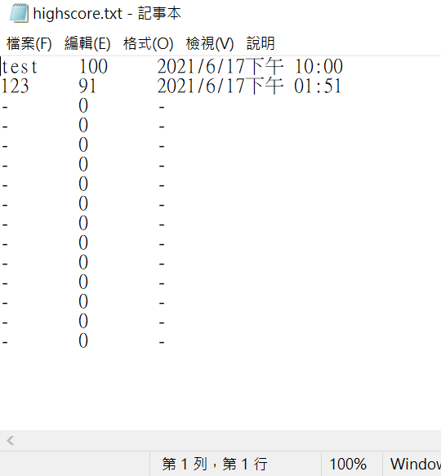
Highscore

Slide 10
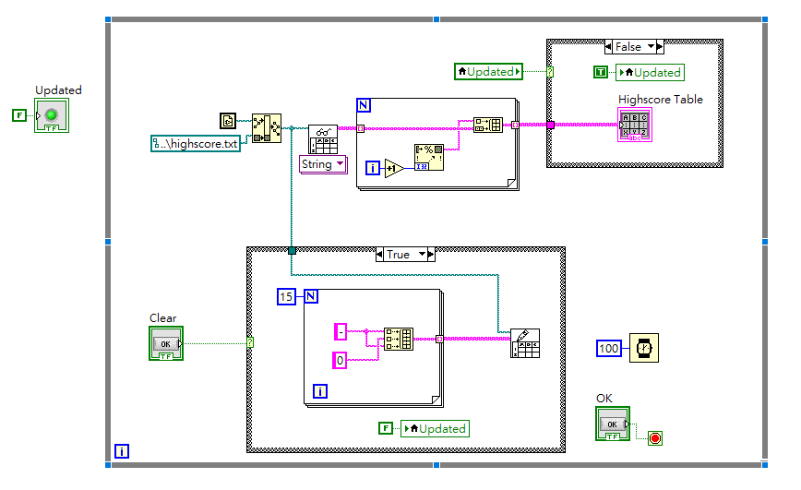

Slide 11
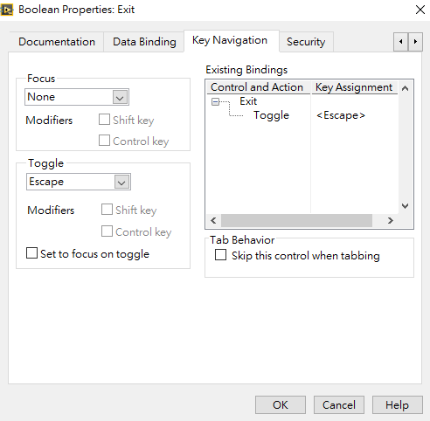



Toggle keyboard
Boolean button properties
toggle button with esc/enter

